Slide 1
Technology Test

Slide 2
CMMI / ISACA Information
The CMMI Institute was acquired by ISACA, hence the slide templates now referring to ISACA.
As documented in the CMMI model Executive Summary, CMMI® (Capability Maturity Model® Integration) is an integrated set of best practices that enable businesses to improve performance of their key business processes.
The CMMI® model was developed by product teams with members from industry and CMMI Institute.
At its heart, the CMMI model provides a clear roadmap for building, improving, and sustaining capability.
Note:
With the above as background, refence to CMMI is now only used in relation to the model and its use, and not as an organization anymore.
ISACA owns all copyright, trademark, and all other intellectual property rights of the CMMI Content.
Notes:
Introduction. Also an opportunity to talk a bit about Demix
Demix has LAs from across the globe and performs appraisals around the world
Demix is one of the largest CMMI services providers globally
Demix also provide other citification services, such as ISO, COBIT, MAX
It is a pleasure and honour to be here with you today. We are looking forward to work with you and your team over the coming days.
早晨好。今天我很高興和榮幸來到這裡，我期待著在未來的几天里與您和您的團隊一起工作。

Slide 3






















It is a pleasure and an honour to be here with you today. We are looking forward to working with you and your team over the coming days.
今天我很高興和榮幸來到這裡，我期待著在未來的几天里與您和您的團隊一起工作。
Notes:
Introduction. Also an opportunity to talk a bit about Demix
Demix has LAs from across the globe and performs appraisals around the world
Demix is one of the largest CMMI services providers globally
Demix also provide other citification services, such as ISO, COBIT, MAX
It is a pleasure and honour to be here with you today. We are looking forward to work with you and your team over the coming days.
早晨好。今天我很高興和榮幸來到這裡，我期待著在未來的几天里與您和您的團隊一起工作。

Slide 4

DEMIXIUM™
Demixium™ Copyright Demix 2021
www.demixium.com
Knowledge | Experience | Results

Slide 5
Appraisal Overview
Notes:
Information in this section should come from the appraisal plan. The idea here is not to duplicate the contents of the plan, but to provide a summary for the Appraisal Sponsor, and the personnel from the OU who will see these findings.
The ATL may add additional information to the final findings presentation, but this minimum content must be present.

Slide 6
Appraisal Overview
Notes:
This is information that must be recorded in the appraisal plan.

Slide 7
Appraisal Overview
Notes:
This is information that must be recorded in the appraisal plan.

Slide 8
Appraisal Team and Support Personnel
Notes:
Take basic information from the appraisal plan.

Slide 9
Appraisal Principles
Start with a process framework
以一个过程框架作为开始
Observe strict confidentiality and non-attribution
严格遵循保密性和不归因性
Involve senior management as appraisal sponsor
把高层作为评估发起人
Approach appraisal collaboratively to the extent possible
评估需要协调合作进行
Focus on action
关注行动
Notes:
1, what ever you share is confidential with the ATM’s and
2, non – your name will not appear in any reports
collaboratively – we have representation from your side as well as ours last at the end there are always weaknesses and from there an improvement action is always undertaken

Slide 10
Virtual appraisals – code of conduct
A virtual appraisal code of conduct must include the following rules at a minimum: (ISACA MDD v2.2)
Participate actively in appraisal activities
No sleeping, multitasking, etc.
To meet confidentiality requirements, ATL may require no additional media or writing materials, laptops, or mobile devices other than those agreed as necessary for conducting virtual activities for some or all interviews
One person speaks at a time
All participants identify themselves when needed, including when asked by ATL, to verify their identity with a government issued photo ID.
Additional required actions
Video cameras should be on at all time.

Slide 11
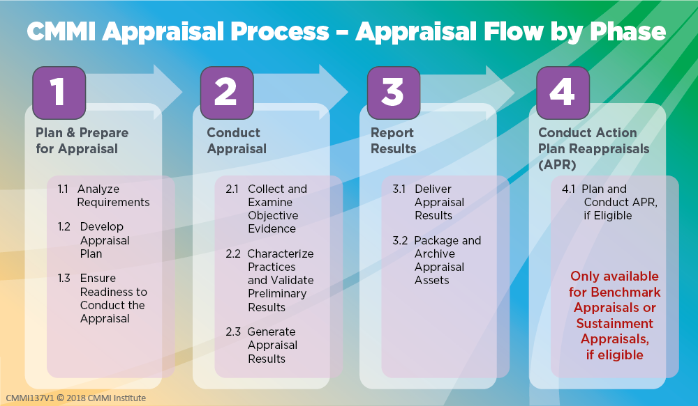

Slide 12


Slide 13
Notice
This pptx has embedded links to 00_Data_Reference.xlsm
The latest information and version of the Benchmark Appraiser Support Environment (BASE) can be accessed at www.demix.org/tools

